Slide 1
PYTHON / DATA ANALYTICS / FINAL PROJECT
E-COMMERCE DELIVERY & SHIPPING
PERFORMANCE ANALYSIS
From order data to delivery performance insights
50,000 orders • Python EDA
PRESENTED BY : PONCY PAUL
FACULTY : ANUSHA H
COORDINATOR : SONA
BATCH : DA52
01
Notes:
Good morning. My name is Poncy Paul. Today I will present my final project on E-Commerce Delivery and Shipping Performance Analysis using Python.

Slide 2
E-COMMERCE DELIVERY & SHIPPING PERFORMANCE ANALYSIS
THE BUSINESS PROBLEM
01
Delivery performance affects customer experience and logistics cost.
02
Orders differ by shipping method, carrier, distance and weather.
03
Analysis can reveal delays, cost drivers and return patterns.
04
Goal: translate shipping data into actionable business insights.
PONCY PAUL |BATCH : DA52 | FINAL PROJECT
02
Notes:
# E-Commerce Delivery and Shipping Performance Analysis Using Python
## Problem Statement
E-commerce companies handle large volumes of orders across different locations, shipping methods, carriers, and product categories. Delivery delays, shipping costs, returns, and customer satisfaction can significantly affect overall business performance.
This project aims to analyze e-commerce delivery and shipping data using Python to identify delivery patterns, evaluate shipping performance, understand the factors associated with delays and returns, and derive meaningful insights that can support better operational and customer-service decisions.

Slide 3
E-COMMERCE DELIVERY & SHIPPING PERFORMANCE ANALYSIS
PROJECT OBJECTIVES
01
Assess delivery status and shipping-method usage.
02
Compare delays and shipping costs across methods and carriers.
03
Examine weather, distance and customer-rating relationships.
04
Analyze return requests and return reasons.
05
Recommend improvements based on exploratory findings.
PONCY PAUL |BATCH : DA52 | FINAL PROJECT
03
Notes:
Introduce the five objectives clearly. This is exploratory analysis, not a predictive machine-learning project.

Slide 4
E-COMMERCE DELIVERY & SHIPPING PERFORMANCE ANALYSIS
DATASET & TOOLS
01
Dataset: 50,000 e-commerce orders.
02
Python with Pandas and NumPy for data handling.
03
Matplotlib and Seaborn for data visualization.
04
GroupBy, pivot tables and correlations for comparative analysis.
05
Order dates used to engineer month and day features.
PONCY PAUL |BATCH : DA52 | FINAL PROJECT
04
Notes:
The dataset was loaded from E-commerce_Delivery_Shipping_Data_2026.csv. Mention the workflow and libraries.

Slide 5
E-COMMERCE DELIVERY & SHIPPING PERFORMANCE ANALYSIS
DATA PREPROCESSING
01
Checked missing values and duplicate records.
02
41,375 missing return_reason values related to no return request.
03
Filled those entries with “Not Applicable”.
04
Converted order_date to datetime.
05
Created order_month and order_day columns.
PONCY PAUL |BATCH : DA52 | FINAL PROJECT
05
Notes:
### Handling Missing Values
The `return_reason` column contains 41,375 missing values. Cross-tabulation confirmed that all missing values correspond to orders where no return was requested. Therefore, these values are contextual rather than data-quality issues and are replaced with `Not Applicable`.
### Feature Engineering
New features are created from the existing data to support deeper exploratory analysis. The order month is extracted from `order_date` to analyze monthly order and delivery patterns.

Slide 6
E-COMMERCE DELIVERY & SHIPPING PERFORMANCE ANALYSIS
ANALYSIS WORKFLOW
01
1. Load and inspect the dataset
02
2. Clean missing values and validate records
03
3. Engineer date-based features
04
4. Summarize, group and cross-tabulate
05
5. Visualize patterns and recommend actions
PONCY PAUL |BATCH : DA52 | FINAL PROJECT
06
Notes:
Describe the logical sequence of the notebook, rather than explaining every line of code.

Slide 7
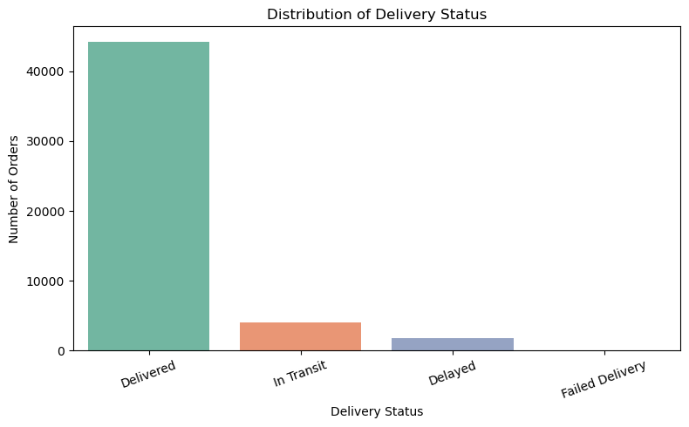
E-COMMERCE DELIVERY & SHIPPING PERFORMANCE ANALYSIS
DELIVERY STATUS
WHAT THE DATA SHOWS
The majority of orders are in the Delivered category (44,184), while 4,007 orders are In Transit and 1,806 are Delayed. Only 3 orders are recorded as Failed Delivery, indicating that failed deliveries are very rare in the dataset.
PONCY PAUL |BATCH : DA52 | FINAL PROJECT
07
Notes:
Introduce this as visualization 1 from the notebook.
Explain the chart: The majority of orders are in the Delivered category (44,184), while 4,007 orders are In Transit and 1,806 are Delayed. Only 3 orders are recorded as Failed Delivery, indicating that failed deliveries are very rare in the dataset.

Slide 8
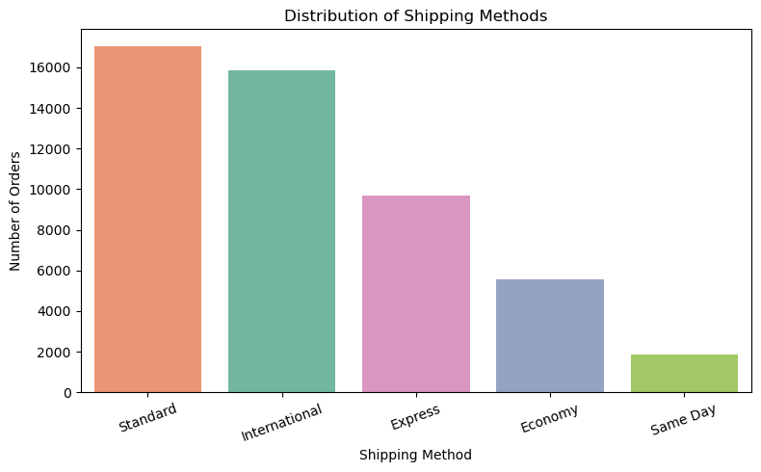
E-COMMERCE DELIVERY & SHIPPING PERFORMANCE ANALYSIS
SHIPPING METHOD MIX
WHAT THE DATA SHOWS
Standard is the most frequently used shipping method with 17,027 orders, followed by International with 15,839 orders and Express with 9,696 orders. Economy accounts for 5,577 orders, while Same Day is the least frequently used method with 1,861 orders.
PONCY PAUL |BATCH : DA52 | FINAL PROJECT
08
Notes:
Introduce this as visualization 2 from the notebook.
Explain the chart: Standard is the most frequently used shipping method with 17,027 orders, followed by International with 15,839 orders and Express with 9,696 orders. Economy accounts for 5,577 orders, while Same Day is the least frequently used method with 1,861 orders.

Slide 9
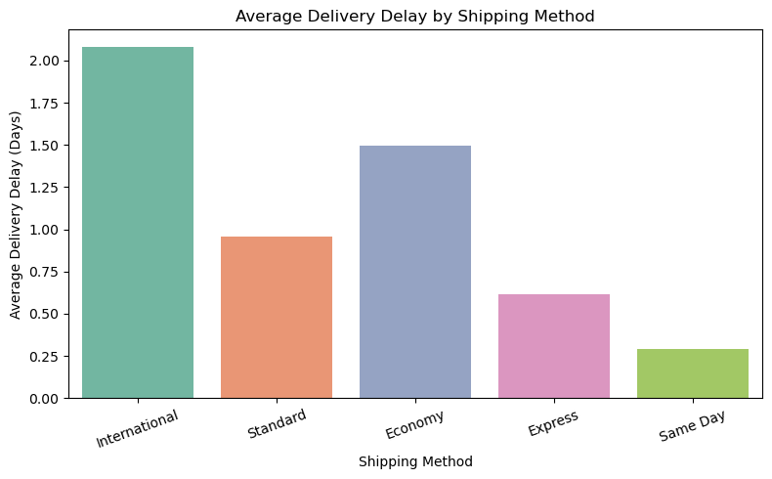
E-COMMERCE DELIVERY & SHIPPING PERFORMANCE ANALYSIS
DELIVERY DELAY BY SHIPPING METHOD
WHAT THE DATA SHOWS
International shipping has the highest average delivery delay at 2.08 days, followed by Economy at 1.50 days. Standard and Express show lower average delays of 0.96 and 0.62 days respectively, while Same Day has the lowest average delay at 0.29 days.
PONCY PAUL |BATCH : DA52 | FINAL PROJECT
09
Notes:
Introduce this as visualization 3 from the notebook.
Explain the chart: International shipping has the highest average delivery delay at 2.08 days, followed by Economy at 1.50 days. Standard and Express show lower average delays of 0.96 and 0.62 days respectively, while Same Day has the lowest average delay at 0.29 days.

Slide 10
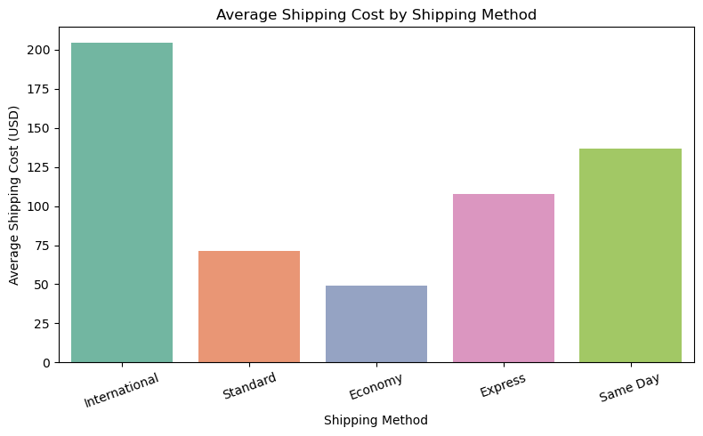
E-COMMERCE DELIVERY & SHIPPING PERFORMANCE ANALYSIS
SHIPPING COST BY METHOD
WHAT THE DATA SHOWS
International shipping has the highest average shipping cost at $204.40, followed by Same Day at $136.58 and Express at $107.58. Standard has an average cost of $71.55, while Economy has the lowest average shipping cost at $48.91.
PONCY PAUL |BATCH : DA52 | FINAL PROJECT
10
Notes:
Introduce this as visualization 4 from the notebook.
Explain the chart: International shipping has the highest average shipping cost at $204.40, followed by Same Day at $136.58 and Express at $107.58. Standard has an average cost of $71.55, while Economy has the lowest average shipping cost at $48.91.

Slide 11
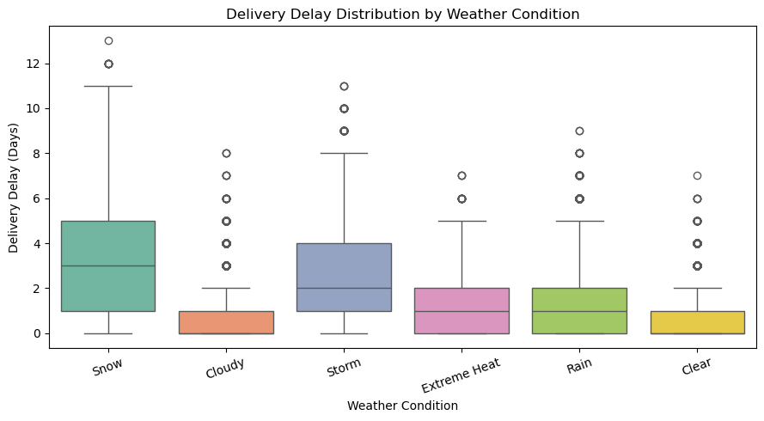
E-COMMERCE DELIVERY & SHIPPING PERFORMANCE ANALYSIS
WEATHER & DELIVERY DELAYS
WHAT THE DATA SHOWS
Delivery delays vary noticeably across weather conditions. Snow shows the highest median delay and the greatest spread, followed by Storm, while Clear and Cloudy conditions generally show lower delays. Several high-delay outliers are also observed across the weather categories.
PONCY PAUL |BATCH : DA52 | FINAL PROJECT
11
Notes:
Introduce this as visualization 5 from the notebook.
Explain the chart: Delivery delays vary noticeably across weather conditions. Snow shows the highest median delay and the greatest spread, followed by Storm, while Clear and Cloudy conditions generally show lower delays. Several high-delay outliers are also observed across the weather categories.

Slide 12
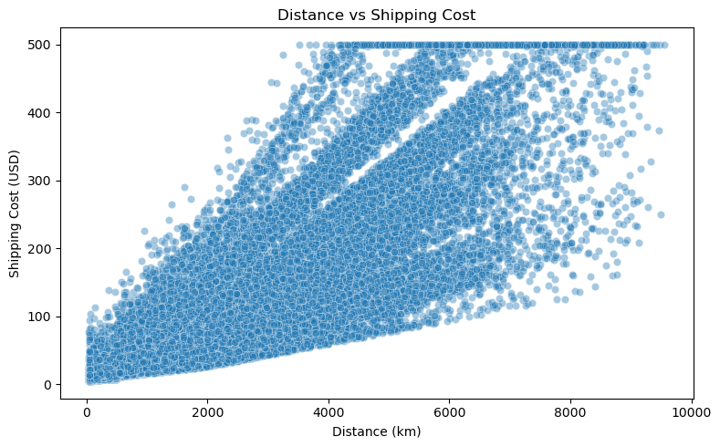
E-COMMERCE DELIVERY & SHIPPING PERFORMANCE ANALYSIS
DISTANCE VS SHIPPING COST
WHAT THE DATA SHOWS
The scatter plot shows a strong positive relationship between delivery distance and shipping cost. Longer delivery distances are generally associated with higher shipping costs, which is consistent with the correlation value of 0.82.
PONCY PAUL |BATCH : DA52 | FINAL PROJECT
12
Notes:
Introduce this as visualization 6 from the notebook.
Explain the chart: The scatter plot shows a strong positive relationship between delivery distance and shipping cost. Longer delivery distances are generally associated with higher shipping costs, which is consistent with the correlation value of 0.82.

Slide 13
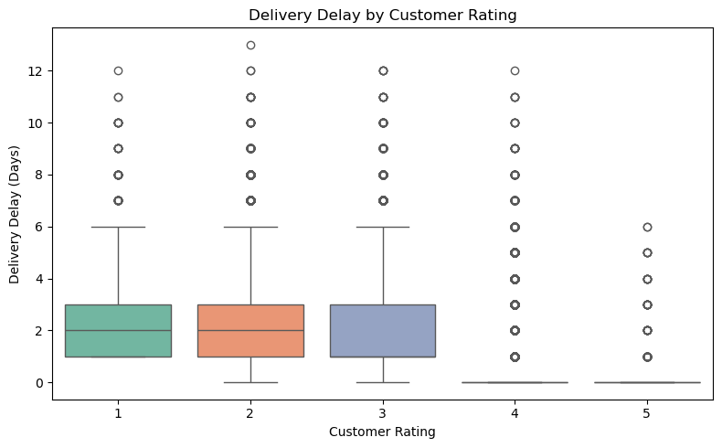
E-COMMERCE DELIVERY & SHIPPING PERFORMANCE ANALYSIS
DELAYS & CUSTOMER RATINGS
WHAT THE DATA SHOWS
Lower customer ratings are associated with higher delivery delays. Ratings 1–3 show higher typical delays, while ratings 4 and 5 generally have little or no delay. This pattern is consistent with the negative correlation (-0.51) between delivery delay and customer rating.
PONCY PAUL |BATCH : DA52 | FINAL PROJECT
13
Notes:
Introduce this as visualization 7 from the notebook.
Explain the chart: Lower customer ratings are associated with higher delivery delays. Ratings 1–3 show higher typical delays, while ratings 4 and 5 generally have little or no delay. This pattern is consistent with the negative correlation (-0.51) between delivery delay and customer rating.

Slide 14
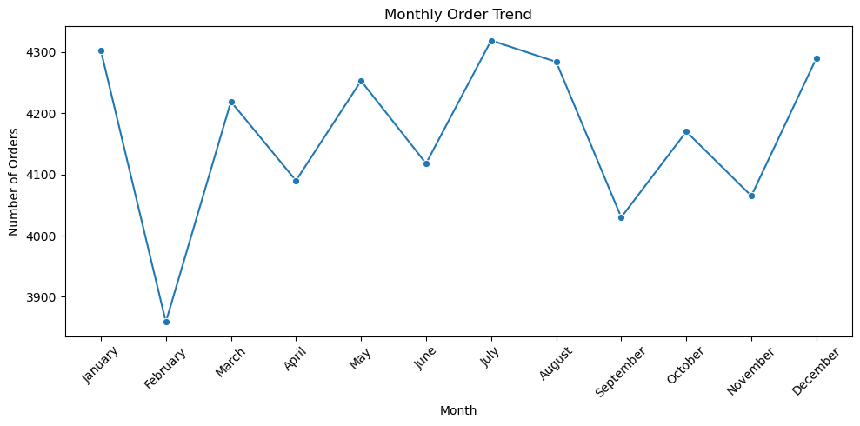
E-COMMERCE DELIVERY & SHIPPING PERFORMANCE ANALYSIS
MONTHLY ORDER VOLUME
WHAT THE DATA SHOWS
Monthly order volume remains relatively stable throughout the year with moderate fluctuations. July records the highest number of orders, while February records the lowest. No strong overall increasing or decreasing trend is observed.
PONCY PAUL |BATCH : DA52 | FINAL PROJECT
14
Notes:
Introduce this as visualization 8 from the notebook.
Explain the chart: Monthly order volume remains relatively stable throughout the year with moderate fluctuations. July records the highest number of orders, while February records the lowest. No strong overall increasing or decreasing trend is observed.

Slide 15
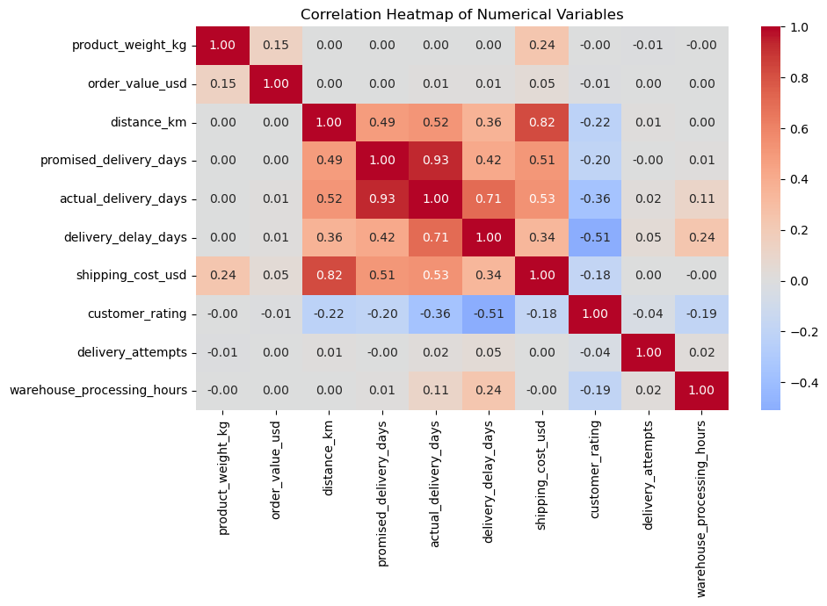
E-COMMERCE DELIVERY & SHIPPING PERFORMANCE ANALYSIS
CORRELATION HEATMAP
WHAT THE DATA SHOWS
The heatmap shows strong positive relationships between promised and actual delivery days (0.93) and between distance and shipping cost (0.82). Actual delivery days and delivery delay are also strongly positively related (0.71). Delivery delay has a moderate negative relationship with customer rating (-0.51), indicating that higher delays are associated with lower customer ratings.
PONCY PAUL |BATCH : DA52 | FINAL PROJECT
15
Notes:
Introduce this as visualization 9 from the notebook.
Explain the chart: The heatmap shows strong positive relationships between promised and actual delivery days (0.93) and between distance and shipping cost (0.82). Actual delivery days and delivery delay are also strongly positively related (0.71). Delivery delay has a moderate negative relationship with customer rating (-0.51), indicating that higher delays are associated with lower customer ratings.

Slide 16
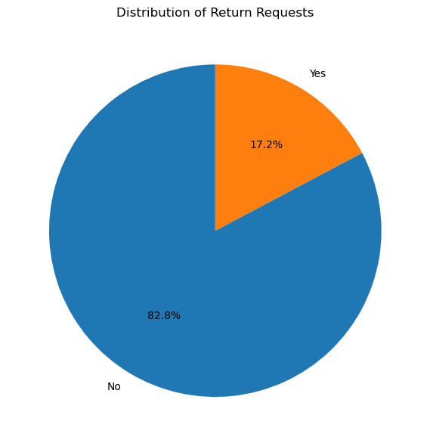
E-COMMERCE DELIVERY & SHIPPING PERFORMANCE ANALYSIS
RETURN REQUEST RATE
WHAT THE DATA SHOWS
The majority of orders (82.8%) did not have a return request, while 17.2% of orders were returned. This shows that return requests represent a relatively smaller proportion of the total orders.
PONCY PAUL |BATCH : DA52 | FINAL PROJECT
16
Notes:
Introduce this as visualization 10 from the notebook.
Explain the chart: The majority of orders (82.8%) did not have a return request, while 17.2% of orders were returned. This shows that return requests represent a relatively smaller proportion of the total orders.

Slide 17
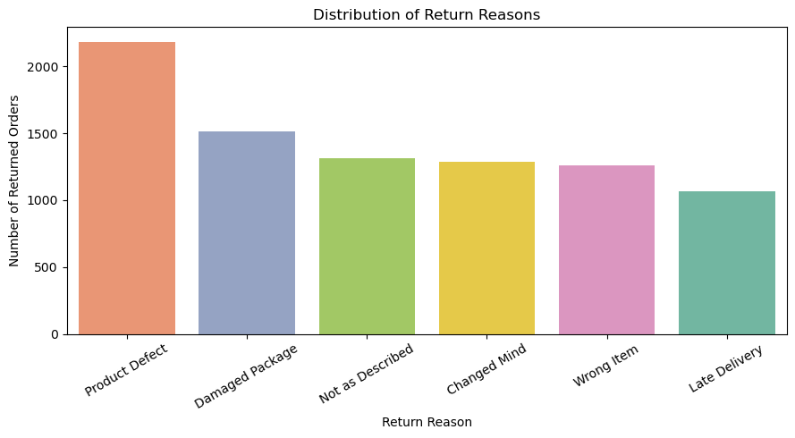
E-COMMERCE DELIVERY & SHIPPING PERFORMANCE ANALYSIS
WHY CUSTOMERS REQUEST RETURNS
WHAT THE DATA SHOWS
Product Defect is the most common reason for product returns, followed by Damaged Package. Not as Described, Changed Mind, and Wrong Item also contribute to returns, while Late Delivery is the least common return reason in the dataset.
PONCY PAUL |BATCH : DA52 | FINAL PROJECT
17
Notes:
Introduce this as visualization 11 from the notebook.
Explain the chart: Product Defect is the most common reason for product returns, followed by Damaged Package. Not as Described, Changed Mind, and Wrong Item also contribute to returns, while Late Delivery is the least common return reason in the dataset.

Slide 18
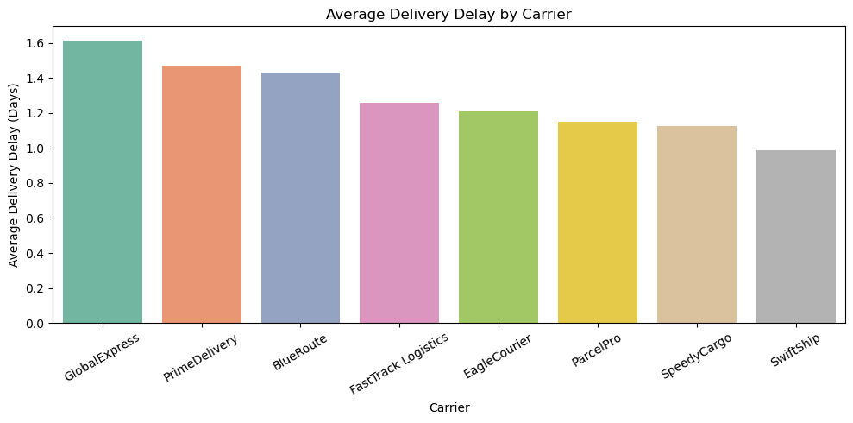
E-COMMERCE DELIVERY & SHIPPING PERFORMANCE ANALYSIS
CARRIER DELAY COMPARISON
WHAT THE DATA SHOWS
Average delivery delay varies across carriers. GlobalExpress shows the highest average delay at approximately 1.61 days, followed by PrimeDelivery and BlueRoute. SwiftShip records the lowest average delay at approximately 0.99 days, indicating comparatively lower delivery delays among the carriers analyzed.
PONCY PAUL |BATCH : DA52 | FINAL PROJECT
18
Notes:
Introduce this as visualization 12 from the notebook.
Explain the chart: Average delivery delay varies across carriers. GlobalExpress shows the highest average delay at approximately 1.61 days, followed by PrimeDelivery and BlueRoute. SwiftShip records the lowest average delay at approximately 0.99 days, indicating comparatively lower delivery delays among the carriers analyzed.

Slide 19
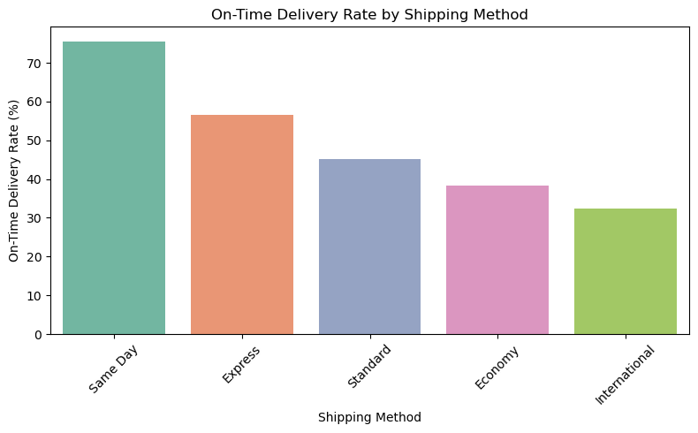
E-COMMERCE DELIVERY & SHIPPING PERFORMANCE ANALYSIS
ON-TIME DELIVERY RATE BY SHIPPING METHOD
WHAT THE DATA SHOWS
This visualization compares the on-time delivery performance of different shipping methods. A higher percentage indicates better delivery reliability. The analysis helps identify which shipping methods are more effective in meeting promised delivery times.
PONCY PAUL |BATCH : DA52 | FINAL PROJECT
Notes:
Explain this visualization: This visualization compares the on-time delivery performance of different shipping methods. A higher percentage indicates better delivery reliability. The analysis helps identify which shipping methods are more effective in meeting promised delivery times.

Slide 20
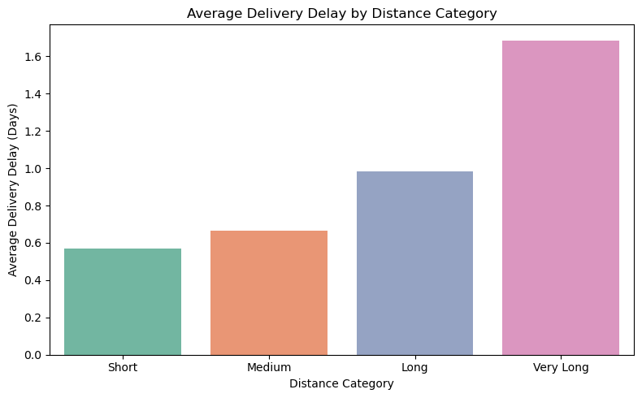
E-COMMERCE DELIVERY & SHIPPING PERFORMANCE ANALYSIS
DELIVERY DELAY BY DISTANCE CATEGORY
WHAT THE DATA SHOWS
This visualization compares the average delivery delay across different distance categories. It helps determine whether delivery distance has an impact on delivery delays and identifies which distance category experiences higher delays.
PONCY PAUL |BATCH : DA52 | FINAL PROJECT
Notes:
Explain this visualization: This visualization compares the average delivery delay across different distance categories. It helps determine whether delivery distance has an impact on delivery delays and identifies which distance category experiences higher delays.

Slide 21
E-COMMERCE DELIVERY & SHIPPING PERFORMANCE ANALYSIS
KEY FINDINGS
01
Standard shipping is the most frequently used method.
02
International shipping has the highest average delay and cost.
03
Longer shipping distance is associated with higher cost.
04
Weather and delivery delays show notable variation.
05
Return requests account for about 17.2% of orders.
PONCY PAUL |BATCH : DA52 | FINAL PROJECT
19
Notes:
### Key Findings
- Standard is the most frequently used shipping method, while Same Day is the least used.
- International shipping has the highest average delivery delay (2.08 days) and the highest average shipping cost ($204.40).
- Same Day shipping has the lowest average delivery delay (0.29 days) and the highest average customer rating (3.84).
- Snow and Storm conditions are associated with higher delivery delays compared with other weather conditions.
- Delivery distance has a strong positive relationship with shipping cost (correlation = 0.82).
- Delivery delay has a moderate negative relationship with customer rating (correlation = -0.51).
- Monthly order volumes remain relatively stable, with July recording the highest volume and February the lowest.
- 17.2% of orders have a return request, with Product Defect being the most common return reason.
- Carrier performance varies, with GlobalExpress showing the highest average delivery delay and SwiftShip the lowest among the carriers analyzed.

Slide 22
E-COMMERCE DELIVERY & SHIPPING PERFORMANCE ANALYSIS
BUSINESS RECOMMENDATIONS
01
Optimize international delivery routes and cost structures.
02
Monitor carrier performance using delay-based KPIs.
03
Plan contingencies for adverse weather conditions.
04
Set realistic delivery expectations for customers.
05
Reduce returns through product and packaging quality controls.
PONCY PAUL |BATCH : DA52 | FINAL PROJECT
20
Notes:
### Business Recommendations
- Optimize international shipping operations to reduce delivery delays and control higher shipping costs.
- Prioritize reliable shipping methods for time-sensitive orders, particularly where faster delivery is required.
- Strengthen contingency planning for Snow and Storm conditions, as these conditions are associated with higher delivery delays.
- Consider delivery distance when planning shipping costs and logistics because longer distances are strongly associated with higher shipping costs.
- Focus on reducing delivery delays to support better customer satisfaction, as higher delays are associated with lower customer ratings.
- Improve product quality checks and packaging controls, since Product Defect and Damaged Package are major reasons for returns.
- Review carrier performance regularly and investigate the operational factors contributing to differences in average delivery delays.

Slide 23
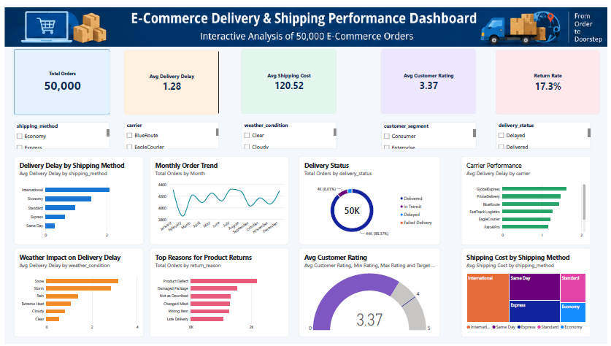
E-COMMERCE DELIVERY & SHIPPING PERFORMANCE ANALYSIS
POWER BI DASHBOARD / OVERVIEW
5 KPI CARDS
50,000 Total Orders
1.28 Avg Delivery Delay
$120.52 Avg Shipping Cost
3.37 Avg Customer Rating
17.3% Return Rate
5 SLICERS
8 ANALYSING CHARTS
PONCY PAUL |BATCH : DA52 | FINAL PROJECT | Source: Uploaded Power BI dashboard PDF • Static screenshot of the interactive report
Notes:
This is the actual Power BI dashboard. Explain how KPI cards summarize the project, and filters allow viewers to investigate shipping methods, carriers, weather, customer segments and delivery statuses. Note that the dashboard shows 17.3% return rate while the Python report rounds to 17.2%; avoid claiming the two values are identical.

Slide 24
E-COMMERCE DELIVERY & SHIPPING PERFORMANCE ANALYSIS
FINAL PROJECT REPORT / DOCUMENTATION
BACKGROUND & OBJECTIVES
DATA PREPARATION
Business context, problem statement and project goals
50,000 orders, 30 original columns, 32 final features; missing values and duplicates
ANALYSIS & EVIDENCE
FINDINGS & RECOMMENDATIONS
EDA, descriptive summaries, correlation analysis and 12 figures documented in the report
11 key findings, operational recommendations, conclusion and future scope
PONCY PAUL |BATCH : DA52 | FINAL PROJECT | Source: Final Project Report • 19 PDF pages (17 numbered content pages plus cover and index)
Notes:
The report provides the written evidence for the project: objectives, source dataset, cleaning decisions, Python methods, findings, recommendations and limitations. The report contains 12 documented figures, while the latest notebook has 14 saved charts.

Slide 25
E-COMMERCE DELIVERY & SHIPPING PERFORMANCE ANALYSIS
PROJECT DELIVERABLES / END-TO-END WORKFLOW
01 SOURCE DATA CSV file from Kaggle
02 PYTHON NOTEBOOK
14 saved charts; exploratory analysis and calculations
03 POWER BI DASHBOARD
KPI cards, filters and visual business monitoring
04 PROJECT REPORT
19-page PDF documenting methods, 12 figures and 11 findings
05 FINAL PRESENTATION
Key findings and operational recommendations communicated clearly
PONCY PAUL |BATCH : DA52 | FINAL PROJECT
Notes:
Explain that Python was used to investigate and prepare findings, Power BI to communicate operational indicators visually, and the report to document the approach and evidence. The latest notebook has 14 charts, but the earlier report documents 12.

Slide 26
E-COMMERCE DELIVERY & SHIPPING PERFORMANCE ANALYSIS
CONCLUSION
01
Python EDA converted order-level records into meaningful insights.
02
Delivery speed, shipping cost and customer experience are interconnected.
03
Findings help prioritize logistics improvement opportunities.
04
Further work could explore forecasting and interactive monitoring.
PONCY PAUL |BATCH : DA52 | FINAL PROJECT
21
Notes:
## 6. Conclusion
This project analyzed e-commerce delivery and shipping performance using Python. The analysis identified meaningful patterns in shipping methods, delivery delays, shipping costs, weather conditions, customer ratings, returns, and carrier performance.
The findings show that delivery performance varies across shipping methods, weather conditions, and carriers. Delivery distance is strongly associated with shipping cost, while higher delivery delays are associated with lower customer ratings. Product defects and damaged packages are also important contributors to product returns.
Overall, the analysis demonstrates how data-driven insights can support improvements in delivery efficiency, cost management, customer satisfaction, and return reduction.

Slide 27
E-COMMERCE DELIVERY & SHIPPING PERFORMANCE ANALYSIS
THANK YOU / QUESTIONS
Thank you for your time.
I am happy to answer your questions.
Faculty: Anusha H | Coordinator: Sona
PONCY PAUL |BATCH : DA52 | FINAL PROJECT
22
Notes:
Thank the evaluator and invite questions.

